Slide 1
AI AGENT CANVAS
Benefit: Reshaping business process Customer Engagement Employee productivity
Name:……………………………………………………………………
BUSINESS CONTEXT
AGENT GOAL
AGENT REASONING FLOW
AGENT ACTIONS
KNOWLEDGE (RAG)
STAKEHOLDERS
RISK & GOVERNANCE
COST AND FEASIBILITY
BUSINESS IMPACT & KPIS

Slide 2
AI AGENT CANVAS
Benefit: Reshaping business process Customer Engagement Employee productivity
Name:………Sample………………………………
BUSINESS CONTEXT
AGENT GOAL
AGENT REASONING FLOW
AGENT ACTIONS
KNOWLEDGE (RAG)
* Business Problem
* Current Workflow (NEW 🔥)
* Pain Points
* Stakeholders
* What job does the agent do?
* What task is reduced/replaced?
* What system actions?
* Send email
* Update database
* Create approval
* Trigger workflow
* Tool:
* Power Automate
* API
* Excel / SharePoint
* Data sources (Excel, SharePoint, SQL)
* Ownership
* Update frequency
* Data quality
* User intent types (topics)
* Clarification logic
* Decision logic
STAKEHOLDERS
RISK & GOVERNANCE
Who involves in the process?
* What AI should NOT do
* Approval checkpoints
* Data sensitivity
COST AND FEASIBILITY
BUSINESS IMPACT & KPIS
License / subscription needed
Development effort (time, resources)
Technical feasibility
Infrastructure / hosting costs
KPI
Time saved
Cost reduction

Slide 3
AI AGENT CANVAS
Benefit: Reshaping business process Customer Engagement Employee productivity
Name:………Sample………………………………
BUSINESS CONTEXT
AGENT GOAL
AGENT REASONING FLOW
AGENT ACTIONS
KNOWLEDGE (RAG)
• Problem: Finance team spends 3 days/month manually compiling reports from Excel
• Current Workflow: Analyst collects data → copies to Word → formats → emails to managers
• Pain Points: Repetitive, error-prone, delays in delivery
• Stakeholders: Finance Manager, Analysts, CFO
• Job: Assist finance team in generating + sending monthly reports automatically
• Task replaced: Manual data compilation and report formatting
• User intents: “Generate monthly report”, “Show Q1 summary”
• Decision logic: Check data → Summarize → Ask user to confirm → Send
• Clarification: “Which month?”, “Include department breakdown?”
• Send email with report (Power Automate)
• Update SharePoint with report status
• Create approval request for manager sign-off
• Data source: Monthly Excel files on SharePoint
• Owner: Finance team uploads by 5th of each month
• Quality: Structured, consistent format, validated by team
STAKEHOLDERS
RISK & GOVERNANCE
• Finance Manager (approver)
• Analysts (end users)
• IT (support)
• CFO (sponsor)
• AI should NOT send reports without user confirmation
• Approval checkpoint before external distribution
• Financial data is confidential → internal only
COST AND FEASIBILITY
BUSINESS IMPACT & KPIS
• Dev effort: ~2 weeks (Power Automate + SharePoint integration)
• Licensing: Existing M365 E3 covers Power Automate + AI Builder
• Feasibility: High — structured data, clear workflow, proven tools
• KPI: Report delivery time reduced from 3 days to 2 hours
• Time saved: ~24 hours/month per analyst
• Error reduction: Eliminate manual copy-paste errors
• Agent Level: Task Automation (Level 3)

Slide 4
AI AGENT CANVAS
Benefit: Reshaping business process Customer Engagement Employee productivity
Name:……………………………………………………………………
WORKFLOW (AS-IS/TO-BE)

Slide 5
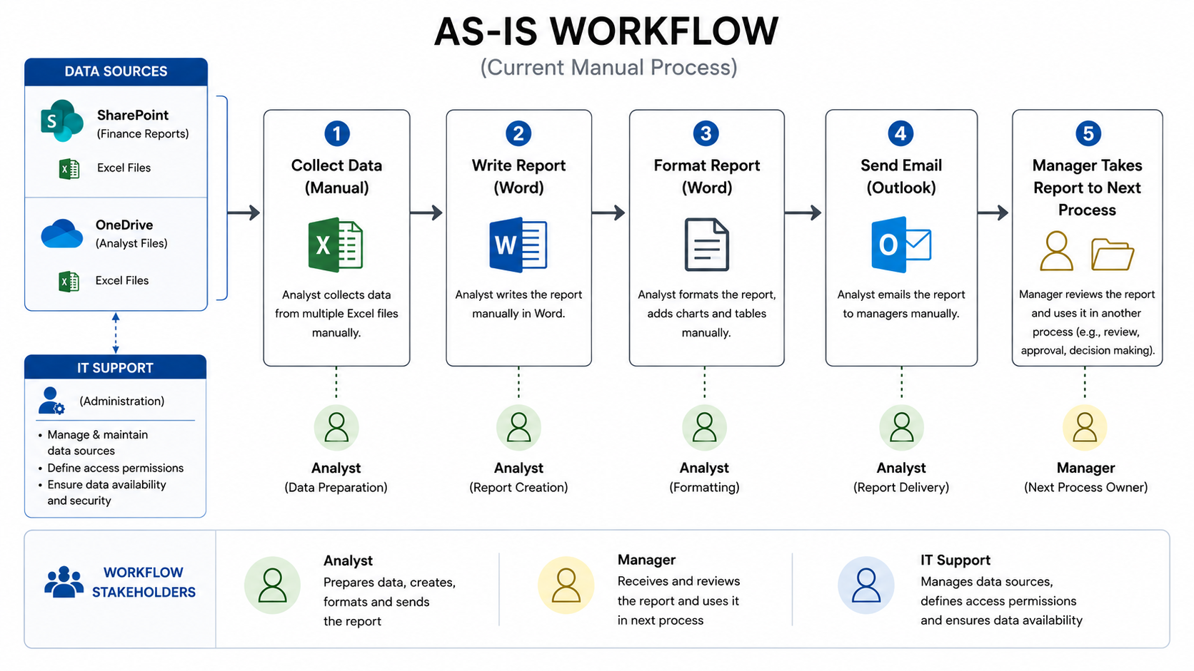

Slide 6
